Slide 1
Business Data Communications
Fourteenth Edition
Jerry FitzGerald, Alan Dennis, and Alexandra Durcikova
Chapter 5
Network and Transport Layers (Part 2)

Slide 2
Learning Objectives
Discuss network addressing techniques.
Discuss network routing protocols.
Discuss the address resolution mechanisms.
Explain how TCP/IP works.

Slide 3
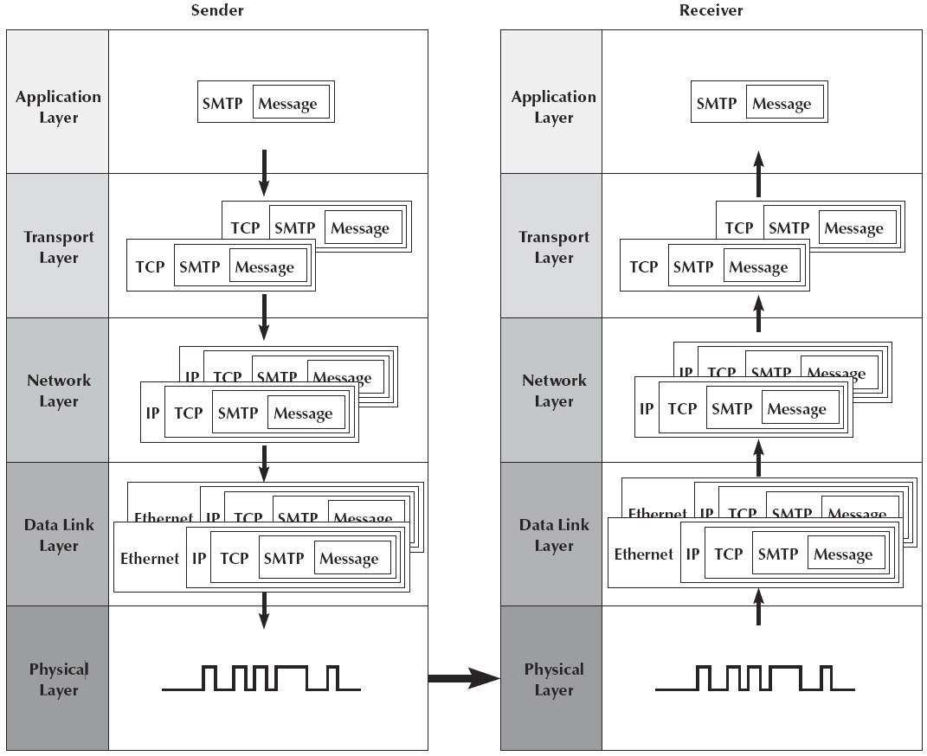
Message Transmission using Layers

Slide 4
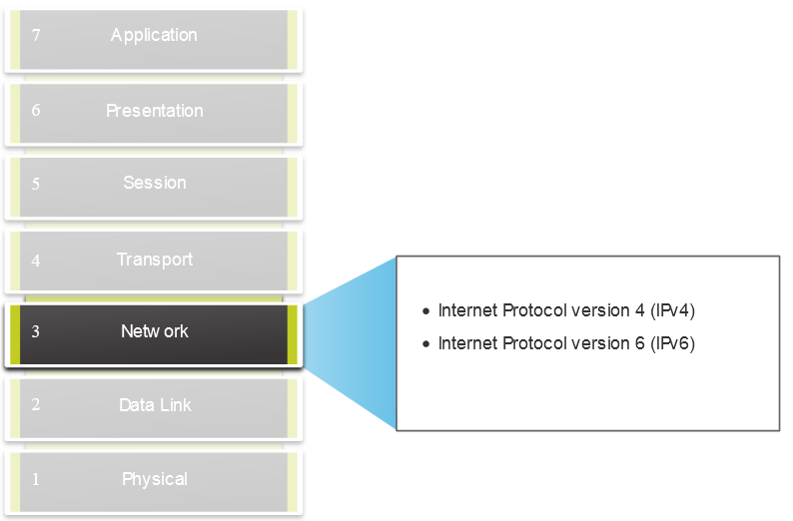
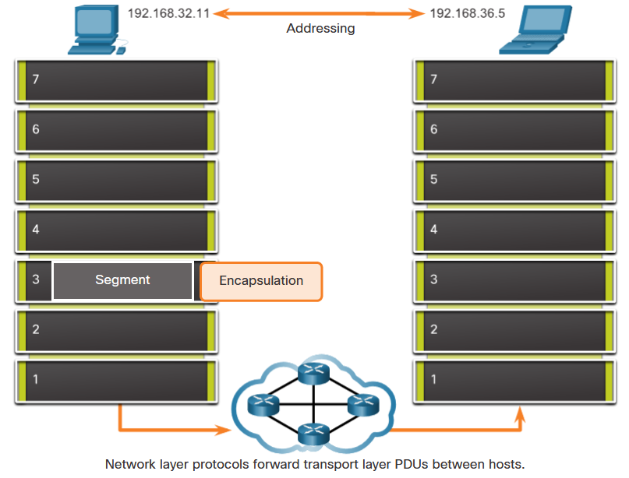
The Network Layer
Provides services to allow end devices to exchange data
IP version 4 (IPv4) and IP version 6 (IPv6) are the main network layer communication protocols.
The network layer performs four basic operations:
Addressing end devices
Encapsulation
Routing
De-encapsulation

Slide 5
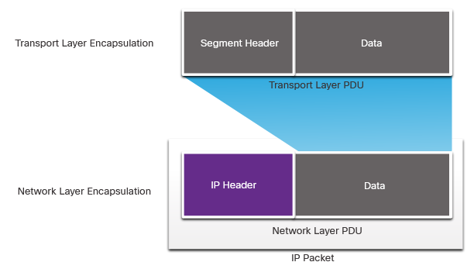
IP Encapsulation
IP encapsulates the transport layer segment.
IP can use either an IPv4 or IPv6 packet and not impact the layer 4 segment.
IP packet will be examined by all layer 3 devices as it traverses the network.
The IP addressing does not change from source to destination.

Slide 6
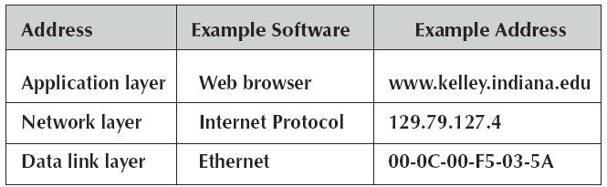
5.4 Addressing
Before you can send a message, you must know the destination address.
Each computer has several addresses, each used by a different layer.
Application software uses the application layer address
Server name

Slide 7
5.4 Addressing Continued
The network layer software uses a network layer address
The network layer protocol used on the Internet is IP.
The network layer identifies the data link layer address of the next computer to which the message should be sent.

Slide 8
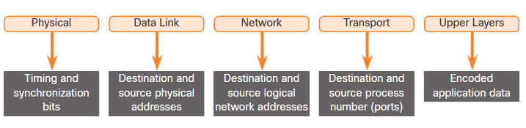
5.4 Addressing Continued
Both the data link and network layers use addressing to deliver data from source to destination.
Network layer source and destination addresses - Responsible for delivering the IP packet from original source to the final destination.
Data link layer source and destination addresses - Responsible for delivering the data link frame from one network interface card (NIC) to another NIC on the same network.

Slide 9
Assigning Addresses
The data link layer address is permanently encoded in each network card
Media access control (MAC) address (e.g., MAC Address)
This address is part of the hardware.
Network layer addresses are assigned by software
Network managers can assign any network layer addresses they want
It is important to ensure that every computer on the same network has a unique network layer address (e.g., IP Address).
Application layer addresses are also assigned by a software configuration file.
Virtually all servers have an application layer address, but most client computers do not.

Slide 10
Internet Addresses
No one is permitted to operate a computer on the Internet unless they use approved addresses.
ICANN (Internet Corporation for Assigned Names and Numbers) is responsible for managing the assignment of network layer addresses and application layer addresses.
Also, ICANN sets the rules by which new domain names are created and IP address numbers are assigned to users.
ICANN also directly manages a set of Internet domains and authorizes private companies to become domain name registrars for those domains.

Slide 11
IPV4: Network and Host Portions

Slide 12
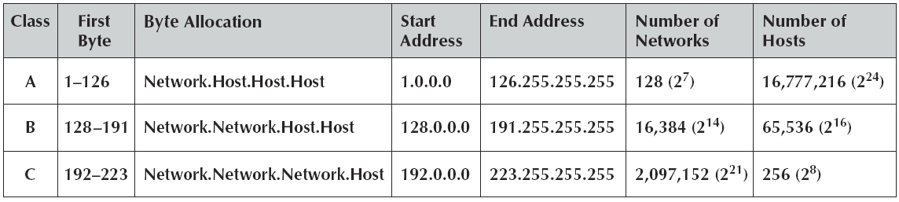
IPv4 Public Address Space
IPv4 uses 32 bits (4 bytes) to define an address.
Therefore, the number of available addresses is 2³² = 4,294, 967,296 or approximately 4.3 billion.
These addresses in the IPv4 address space are divided into Internet address classes.

Slide 13
IPv4 Public Address Space Continued
There are three classes of addresses that can be assigned: Class A, Class B, and Class C.
Addresses are assigned into a particular class by the value of the first byte.
The first byte can be any number from 0 to 255.
There are some numbers in the first byte range that are not assigned to any address range.

Slide 14
IPv4 Public Address Space Continued
An address starting with 0 is not allowed.
The 127 Address range is reserved for a computer to communicate with itself (loopback).
Addresses starting from 224 are reserved addresses.

Slide 15
IPv4 Public Address Space Continued
Addresses from 224 to 239 belong to Class D and are reserved for multicasting.
Addresses from 240 to 254 belong to Class E and are reserved for experimental use.
Addresses starting with 255 are reserved for broadcast messages.
Within each class, there is a set of addresses that are labeled as private IPv4 address space.

Slide 16
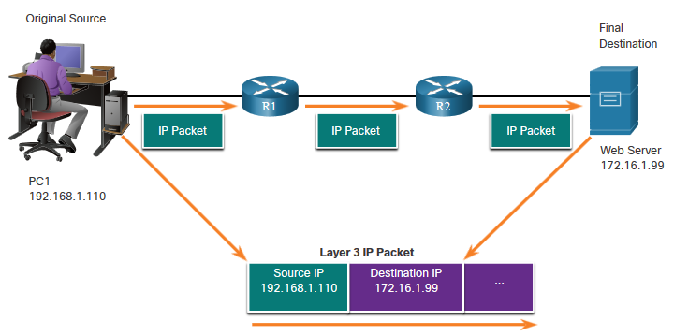
Layer 3 Logical Address
An IP address contains two parts:
Network portion (IPv4) or Prefix (IPv6)
The left-most part of the address indicates the network group which the IP address is a member.
Each LAN or WAN will have the same network portion.
Host portion (IPv4) or Interface ID (IPv6)
The remaining part of the address identifies a specific device within the group.
This portion is unique for each device on the network.

Slide 17
Subnets
Each organization must assign the IP addresses it has received to specific computers on its networks.
This is done using an addressing hierarchy
The first part of the address defines the network.
The second part defines a particular computer or host on the network.
It is not efficient to assign every computer to the same network.
Rather, subnetworks or subnets are designed on the network that subdivide the network into logical pieces.

Slide 18
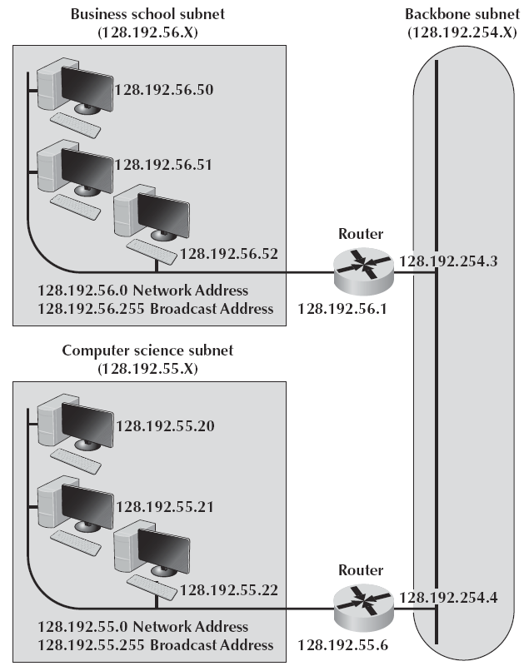
Address Subnets
It is customary to assign all the computers in the same LAN numbers that start with the same first three digits.
Two addresses on this subnet cannot be assigned as IP address to any computer.
The first address is 128.192.56.0, and this is the network address.
The second address is 128.192.56.255, which is the broadcast address.
Routers connect two or more subnets so they have a separate address on each subnet.

Slide 19
Subnet mask – Examples >> is used to determine whether a host is on the local subnet or on a remote network.
A subnet mask of 255.255.255.0
1st 3-byte indicate the same subnet
A subnet mask of 255.255.0.0
1st 2-byte indicate the same subnet
Subnet mask of 255.255.255.128
11111111.11111111.11111111.10000000
1st 3-byte plus the first bit in the fourth byte indicate the subnet

Slide 20
Determining the Network: Logical AND
To identify the network address, the host IPv4 address is logically ANDed, bit by bit, with the subnet mask to identify the network address.

Slide 21
The Prefix Length
The prefix length is the number
of bits set to 1 in the subnet
mask.
• It is written in “slash notation”
therefore, count the number of
bits in the subnet mask and
prepend it with a slash.

Slide 22
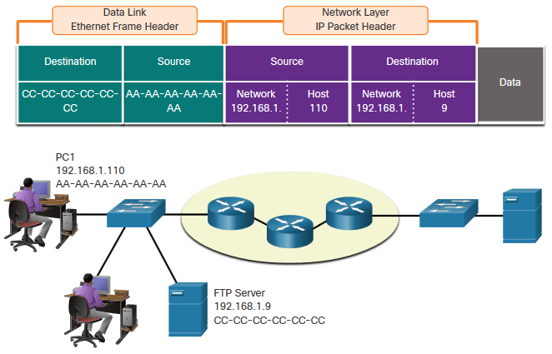
Data Access: Devices on the same network
When devices are on the same network the source and destination will have the same number in network portion of the address.
PC1 – 192.168.1.110
FTP Server – 192.168.1.9

Slide 23
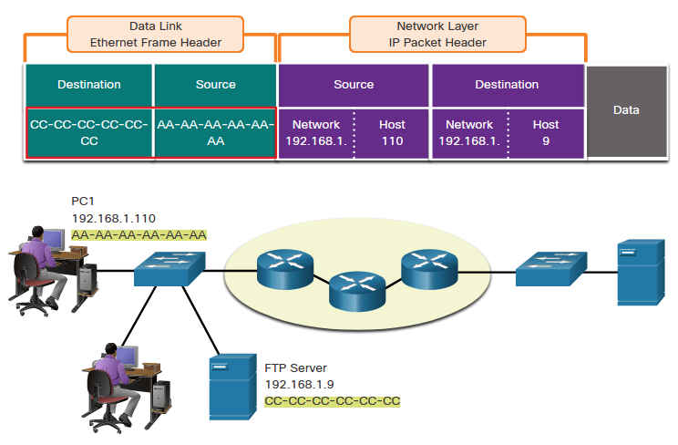
Role of the Data Link Layer Addresses: same IP network
When devices are on the same Ethernet network the data link frame will use the actual MAC address of the destination NIC.
MAC addresses are physically embedded into the Ethernet NIC and are local addressing.
The Source MAC address will be that of the originator on the link.
The Destination MAC address will always be on the same link as the source, even if the ultimate destination is remote.

Slide 24
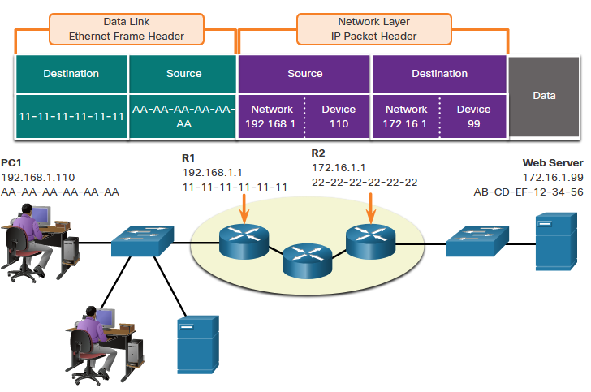
Devices on a Remote Network
What happens when the actual destination is not on the same LAN and is remote?
What happens when PC1 tries to reach the Web Server? Does this impact the network and data link layers?
When the source and destination have a different network portion, this means they are on different networks.
PC1 – 192.168.1
Web Server – 172.16.1

Slide 25
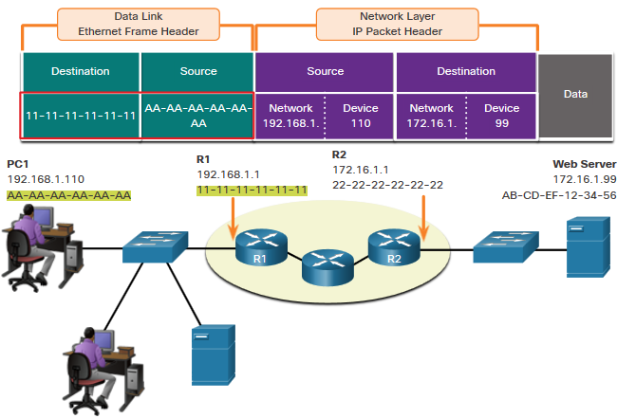
Role of the Data Link Layer Addresses: Different IP Networks
When the final destination is remote, Layer 3 will provide Layer 2 with the local default gateway IP address, also known as the router address.
The default gateway (DGW) is the router interface IP address that is part of this LAN and will be the “gateway” to all other remote locations.
All devices on the LAN must be told about this address or their traffic will be confined to the LAN only.
Once Layer 2 on PC1 forwards to the default gateway, the router then can start the routing process of getting the information to actual destination.
Notes:
3 – Protocols and Models
3.7 – Data Access
3.7.7 – Role of the Data Link Layer Addresses: Different IP Networks

Slide 26
Role of the Data Link Layer Addresses: Different IP Networks
The data link addressing is local addressing so it will have a source and destination for each link.
The MAC addressing for the first segment is:
Source – AA-AA-AA-AA-AA-AA (PC1) Sends the frame.
Destination – 11-11-11-11-11-11 (R1- Default Gateway MAC) Receives the frame.
Note: While the L2 local addressing will change from link to link or hop to hop, the L3 addressing remains the same.
Notes:
3 – Protocols and Models
3.7 – Data Access
3.7.7 – Role of the Data Link Layer Addresses: Different IP Networks (Cont.)

Slide 27
Dynamic Addressing
To this point, we have said that every computer knows its network layer address from a configuration file.
This leads to a major network management problem.
Any time a computer is moved, or its network is assigned a new address, the software on each individual computer must be updated.
The easiest way around this is dynamic addressing
A server is designated to supply a network layer address to a computer each time the computer connects to the network.
The most common standard for dynamic addressing is the Dynamic Host Configuration Protocol (DHCP).

Slide 28
Address Resolution
To send a message, the sender must be able to translate the application layer address of the destination into a network layer address and in turn translate that into a data link layer address.
This is called address resolution
TCP/IP uses two different approaches:
One for resolving application layer addresses into IP addresses
One for resolving IP addresses into data link layer addresses.

Slide 29
Server Name Resolution
Server name resolution is the translation of application layer addresses into network layer addresses.
This is done using the Domain Name Service (DNS).
Throughout the Internet, a series of computers called name servers provide DNS services.
These name servers have address databases that store thousands of Internet addresses and their corresponding IP addresses.
Every organization that has many servers also has its own DNS server.
Smaller organizations that have only one or two servers often use a DNS server provided by their ISP.

Slide 30
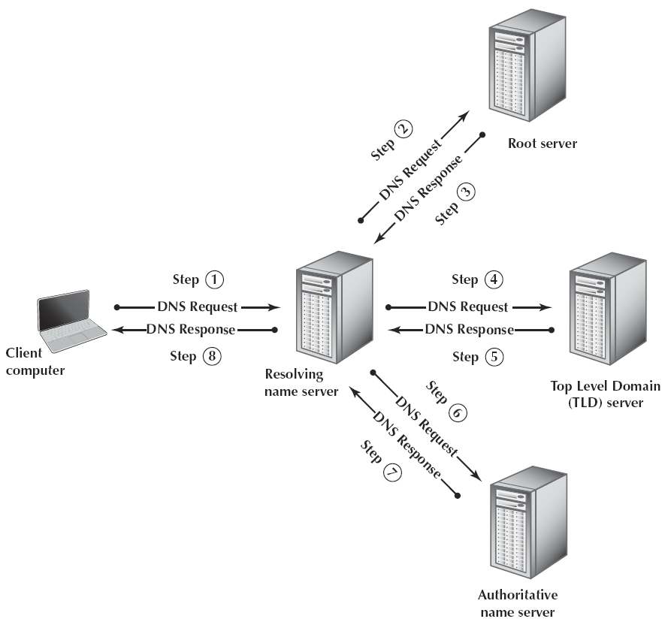
How the DNS System Works
When a computer needs to translate an application layer address into an IP address, it sends a special DNS request packet to its DNS server.
It asks the DNS server for the IP address that matches an Internet application layer address.
If it has a matching name in its database, it sends back the IP address.
If it does not have that address in its database, it will issue the same request to another DNS server.

Slide 31
How the DNS System Works Continued
The local DNS server is called the resolving name server
When it does not know the address, it contacts a root server
If it does not know, it responses with the address of the top-level domain server for the requested website.
This is called the authoritative name server.

Slide 32
Data Link Layer Address Resolution
To actually send a message, the network layer software must know the data link layer address of the receiving computer.
The TCP/IP software sends a broadcast message to all computers in its subnet.
The message is a specially formatted request using Address Resolution Protocol (ARP) that says, “Whoever is IP address xxx.xxx.xxx.xxx, please send me your data link layer address”.
The software in the computer with that IP address then sends an ARP response with its data link layer address.

Slide 33
Data Link Layer Address Resolution
To actually send a message, the network layer software must know the data link layer address of the receiving computer.
The TCP/IP software sends a broadcast message to all computers in its subnet.
The message is a specially formatted request using Address Resolution Protocol (ARP) that says, “Whoever is IP address xxx.xxx.xxx.xxx, please send me your data link layer address”.
The software in the computer with that IP address then sends an ARP response with its data link layer address.

Slide 34
QUIZ 1
The network layer provides guaranteed end-to-end delivery of the message.
Ans: False

Slide 35
QUIZ 2
A subnet mask of 255.255.255.0 means that all computers with only the same first two bytes in their IPv4 addresses are on the same subnet (TRUE/FALSE)?
Ans: False

Slide 36
QUIZ 3
A subnet mask of 255.255.0.0, the first two bytes indicate the same subnet.(TRUE/FALSE)
Ans: True

Slide 37
QUIZ 4
UDP is not commonly used for:
a. network management control messages
b. RIP messages
c. DHCP addressing messages
d. HTTP requests
e. DNS requests
Ans: d. HTTP requests

Slide 38
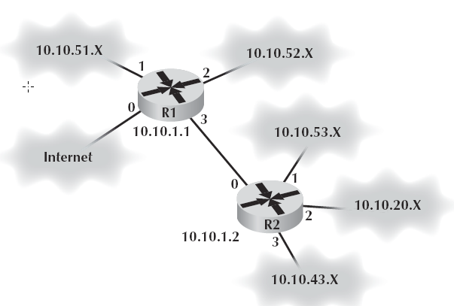
5.5 Routing
Routing is the process of determining the route or path through the network that a message will travel.
There may be many possible routes
Routing is done by special devices called routers.
Every router has a routing table that specifies how messages will travel through the network.

Slide 39
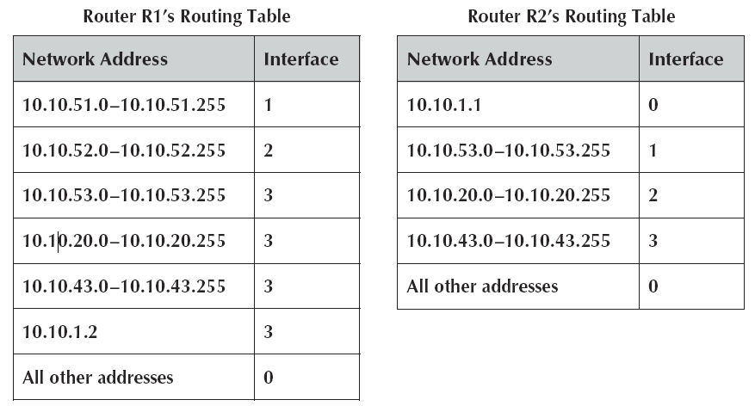
Sample Routing Tables

Slide 40
Types of Routing
Centralized routing
All routing decisions are made by one central computer or router.
Static routing
All computers or routers in the network make their own routing decisions following a formal routing protocol.
Dynamic routing
Also called adaptive routing.
Routing decisions are made in a decentralized manner by individual computers.
With distance vector dynamic routing, routers count the number of hops along a route.
With link state dynamic routing, computers or routers track the number of hops in the route, the speed of the circuits in each route, and how busy each route is.

Slide 41
Multicasting
The most common type of message is the transmission between two computers
This is called a unicast message
A broadcast message is sent to all computers on a specific LAN or subnet
A multicast message is used to send the same message to a group of computers.
Computers wishing to participate in a multicast send a message to the sending computer or some other computer performing routing along the way using a special type of packet called Internet Group Management Protocol (IGMP)

Slide 42
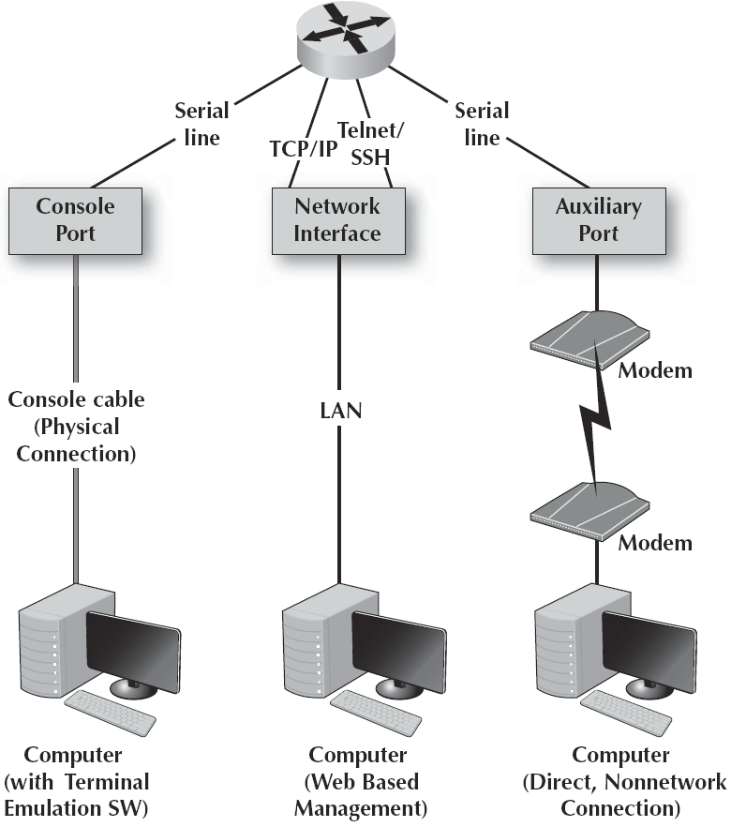
Anatomy of a Router
A router has three main functions:
It determines a path for a packet to travel over.
It transmits the packet across the path.
It supports communication between a wide variety of devices and protocols.
Routers are essentially special-purpose computers.

Slide 43
Anatomy of a Router Continued
There are three ways a network manager can connect to a router and configure and maintain it:
Console port
Network interface port
Auxiliary port
New routers do not have an IP address assigned
So, the console port, also called the management port, is used to configure it
Network interface port used for routine maintenance.

Slide 44
Anatomy of a Router Continued
A router must have an operating system.
The operating system that is used in about 90% of routers is the Cisco Internetwork Operating Systems (IOS).
The Access Control List (ACL) file defines what types of packets should be routed and what types of packets should be discarded.

Slide 45
5.6 TCP/IP Example
When a computer is installed on a TCP/IP network, it must be given four pieces of the network layer addressing and routing information.
Its IP address
A subnet mask
The IP address of a DNS server
The IP address of an IP gateway
A server would also need to know its application layer address.

Slide 46
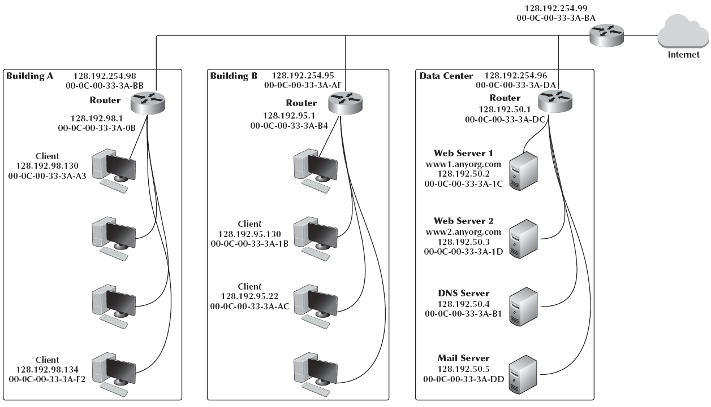
Example TCP/IP Network
Three LANs connected by a BN.
The BN also has a connection to the Internet.
Each building is configured as a separate subnet.
Each building is connected to the BN via a router.
The organization has a couple Web servers, one DNS server, and one Mail server located in the data center.

Slide 47
Known Address
Suppose that a client computer in Building A wanted to get a Web page from a Web server 1 located in the data center.
We will assume that this computer knows the network layer and data link layer addresses.
Because the computer knows the IP address of the server, it uses its IP address, not its application layer address.
The application layer software would pass an HTTP packet to the transport layer software (TCP) with the Internet address of the destination www1.anyorg.com: 128.192.50.2.
The transport layer software (TCP) would make sure that the request fits in one segment and hands it to the network layer.

Slide 48
Known Address Continued
The network layer software (IP) would then check the subnet mask and would recognize that the Web server is located outside of its subnet.
The network layer software would check its address table and find the Ethernet address for the router.
The data link layer would surround the frame with an Ethernet frame and transmit it over the physical layer to the Web server.
The router would receive the message and its data link layer would perform error checking before passing the packet to the network layer software.
The network layer software would read the IP address to determine the final destination.

Slide 49
Known Address Continued
This router in the data center would receive the message and read the IP address to determine the final destination.
The router would recognize that this address was inside its 128.192.50.x subnet and would search its data link layer address table for this computer
It would then pass the packet to the data link layer along with the Ethernet address.
The www1.anyorg.com Web server would receive the message and process it.
This process would work in the same way for Web servers located outside the organization on the Internet.

Slide 50
5.7 Implications for Cyber Security
Security was not a major design focus for the original design of the Internet and TCP/IP.
One of the most exploited security flaws is the vulnerability created by the TCP three-way handshake that initiates a connection between a client and a server.
The most basic way somebody can identify you on the Internet is by your IP address.
Most websites can track your operating system, browser version, time zone, and may other information in addition to your IP address.

Slide 51
Optional (Extra material)

Slide 52
Unknown Addresses
Suppose that the client computer in Building A wants to retrieve a Web page from the www1.anyorg.comWeb server but does not know the IP address.
We will assume that the client knows the data link layer address of its subnet router.
The Web browser realizes that it does not know the IP address after searching its IP address table.
It issues a DNS request to the name server.
The DNS request is passed to the transport layer (TCP), which attaches a UDP datagram and hands the message to the network layer.

Slide 53
Unknown Addresses Continued
Using its subnet mask, the network layer (IP) will recognize that the DNS server is outside of its subnet.
It will attach an IP packet and set the data link layer address to its router’s address.
The router will recognize it must send the packet to the data center router, 128.192.254.96 and does this by using this router’s MAC address.
When the data center router receives this packet, it will transmit the packet using the DNS server’s Ethernet address.
The name server will process the DNS request and send the matching IP address back to the client via the 128.192.98.x subnet router.

Slide 54
Unknown Addresses Continued
The IP address for the desired computer makes its way back to the application layer software.
The application layer then issues the HTTP request using the IP address for the Web server and passes it to the transport layer, which in turn passes it to the network layer.
The network layer will route the packet to its default gateway, which will then send the HTTP request to the data center’s router, which will deliver the HTTP request to Web server 1.

Slide 55
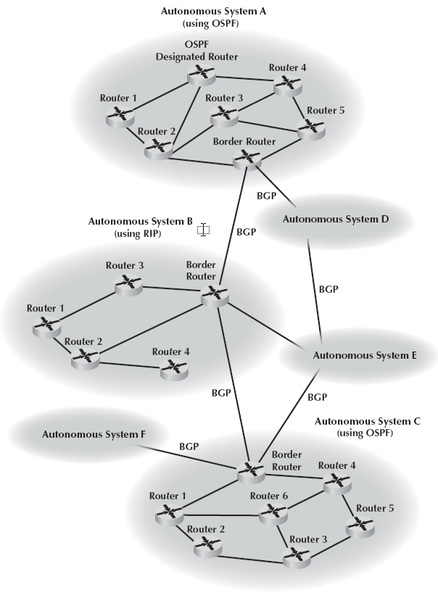
Routing Protocols
An autonomous system is simply a network operated by one organization
The routing protocols are called interior routing protocols.
Protocols used between autonomous systems are called exterior routing protocols.
Border Gateway Protocol (BGP) is a dynamic distance vector exterior routing protocol used to exchange routing information between autonomous systems.

Slide 56
Routing Protocols Continued
Internet Control Message Protocol (ICMP) is simply an error-reporting protocol that enables computers to report routing errors to message senders.
Routing Information Protocol (RIP) is a dynamic distance vector interior routing protocol that is commonly used in smaller networks.

Slide 57
Routing Protocols Continued
Intermediate System to Intermediate System (IS-IS) is a link state interior routing protocol that is commonly used in large networks.
Open Shortest Path First (OSPF) is a dynamic hybrid interior routing protocol
It uses the number of computers in a route as well as network traffic and error rates to select the best route.

Slide 58
Routing Protocols Continued
Enhanced Interior Gateway Routing Protocol (EIGRP) is a dynamic hybrid interior routing protocol.
Hybrid means that it has some features that act like distance vector protocols and some that act like link state protocols.
EIGRP is an improved version of the Interior Gateway Routing Protocol (IGRP).

Slide 59
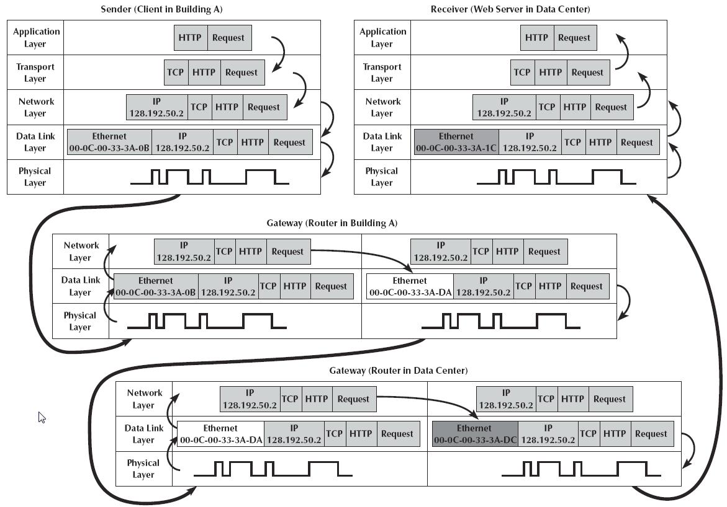
How Messages Move Through the Network Layers

